Slide 1

Physical examination
Pediatric Physical Assessment
Third Stage
Dr. Moustafa Ali Alshammari
Pediatric Nursing

Slide 2
Pediatric Physical Assessment

Slide 3
Health Assessment
Collecting Data
  By observation
  Interviewing the parent
  Interviewing the child
  Physical examination

Slide 4
Bio-graphic Demographic
Name, age, health care provider
Parents name age /siblings age
Ethnicity / cultural practices
Religion / religious practices
Parent occupation
Child occupation: adolescent

Slide 5
Past Medical History
Allergies
Childhood illness
Trauma / hospitalizations
Birth history
Did baby go home with mom / special care nursery
Genetics: anything in the family

Slide 6
Current Health Status
Immunizations
Any underlying illness / genetic condition
What concerns do you have today?

Slide 7
Review of systems
Ask questions about each system
Measuring data: growth chart, head and chest circumference, BMI
Nutrition: breast fed, formula, eating habits
Growth and development: How does parent think child is doing? Six questions

Slide 8
Physical Assessment
General appearance & behavior
  Facial expression
  Posture / movement
  Hygiene
  Behavior
  Development: grossly fits guidelines for age

Slide 9
Vital Signs
Temperature: rectal only when absolutely necessary
Pulse: apical on all children under 1 year
Respirations: infant uses abdominal muscles
Blood pressure: admission base line
Height and weight and head circumference for 2 years and younger

Slide 10
Physical Assessment
Skin, hair nails
Head, neck, lymph nodes: fontanelles
Eyes, nose, throat…look at palate and teeth
Chest: auscultate for breath sounds and adventitious sounds
Breasts: tanner scale
Heart: PMI, murmurs

Slide 11
Physical Assessment
Abdomen
Genitalia: tanner scale, discharge, testicles
Anus: inspect for cracks or fissures
Musculoskeletal: Ortaloni maneuver / Barlows
Feet / legs / back / gait

Slide 12
Neurological
Glasgow coma scale
Observe their natural state: Play games with them, especially children under 5 year
CNS grossly intact: II – XII

Slide 13
Newborn reflexes
Rooting: disappears at 3-4 months
Sucking: disappears at 10 to 12 months
Palmar grasp: disappears at 3 to 4 months
Plantar grasp: disappears at 8 to 10 months
Tonic neck: disappears by 4 to 6 months
Moro (startle): disappears by 3 months
Babinski: disappears by 2 years
Stepping reflex: disappears by 2 months

Slide 14
Infant Exam
Examine on parent lap
Leave diaper on
Comfort measures such as pacifier or bottle.
Talk softly
Start with heart and lung sounds
Ear and throat exam last

Slide 15
Toddler Exam
Examine on parent lap if uncooperative
Use play therapy
Distract with stories
Let toddler play with equipment / BP
Call by name
Praise frequently
Quickly do exam

Slide 16
Preschool Exam
Allow parent to be within eye contact
Explain what you are doing
Let them feel the equipment

Slide 17
School-age Child
Allow the older child the choice of whether to have a parent present
Teaching about nutrition and safety
Ask if the child has any concerns or questions
How are they doing in school?
Do they have a group of friends they hand out with?
What do they like to do in their free time?

Slide 18
School-age Exam
Allow choice of having parent present
Privacy and modesty.
Explain procedures and equipment.
Interact with child during exam.
Be matter of fact about examining genital area.

Slide 19
Adolescent
Ask about parent in the room
Should have some private interview time: time to ask the difficult questions
HEADSS: home life, education, alcohol, drugs, sexual activity / suicide
Privacy issues

Slide 20
Vital Signs
Choose your words carefully when explaining vital sign measurements to a young child. Avoid saying, for example, “I’m going to take your pulse now.” The child may think that are going to actually remove something from his or her body. A better phrase would be “I’m going to count how fast your heart beats.”

Slide 21
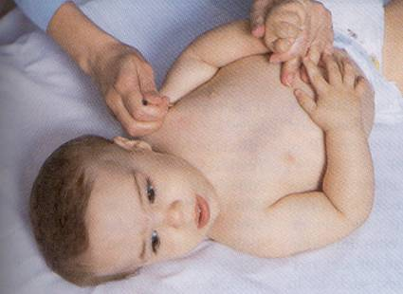
Temperature
Position for taking
axillary temperature.
Whaley and Wong

Slide 22
Temperature
Use of tympanic membrane is controversial.
Oral temperature for children over 5 to 6 years.
Rectal temperatures are contraindicated if the child has had anal surgery, diarrhea, or rectal irritation.
Check with hospital policy.

Slide 23
Pulse
Apical pulse for infants and toddlers under 2 years
Count for 1 full minute
Will be increased with: crying, anxiety, fever, and pain

Slide 24
Pulse rates
Neonate: 70 – 190
1-year: 80 – 160
2-year: 80-130
4-year: 80 – 120
6-year: 75-115
10-year: 70-110
14-year: 65 – 105 / males 60 – 100
18-year: 55-95 / males 50 - 90

Slide 25
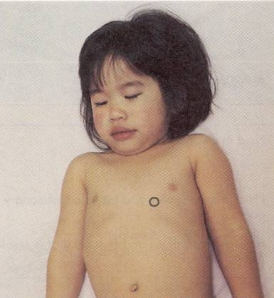
Apical Pulse
In child younger than 7 years.

Slide 26
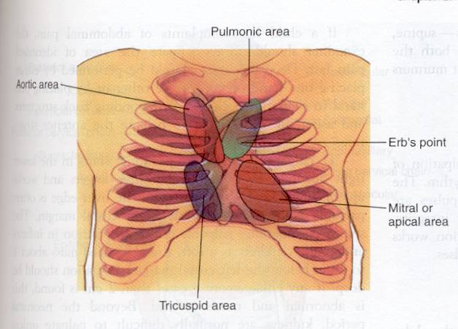
Heart Sounds
See table 6-5, Bowden & Greenberg text

Slide 27
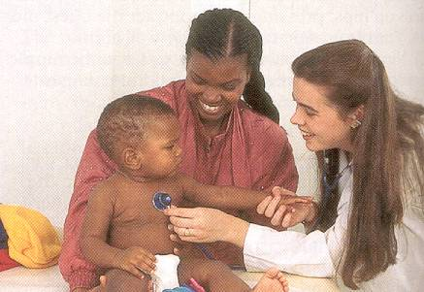
Auscultating Heart Sounds
Pillitteri

Slide 28
Respiratory
Count for one full minute
May want to do before you wake the infant up
Rate will be elevated with crying / fever
  Pre-term: 40 – 60
  Newborn: 30 – 40
  Toddler: 25
  School-age: 20
  Adolescent: 16
  Panic levels: < 10 or > 60

Slide 29
Clinical Tip
To accurately assess respirations in an infant or small child wait until the baby is sleeping or resting quietly.
You might need to do this before you do more invasive exam.
Count the number of breaths for an entire minute.

Slide 30
Blood Pressure
The width of the rubber bladder should cover two thirds of the circumference of the arm, and the length should encircle 100% of the arm without overlap.
Crying can cause inaccurate blood pressure reading.
Consider norms for age.

Slide 31
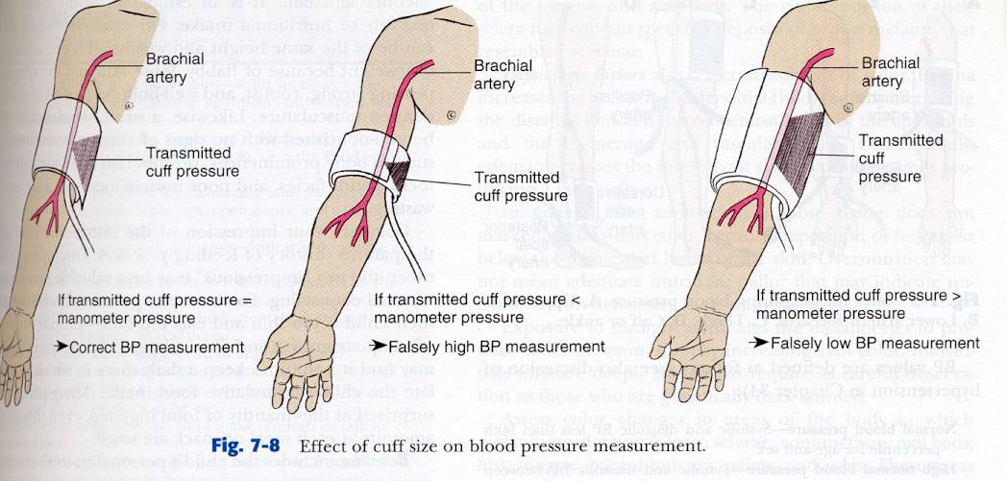
Blood Pressure Cuff
Whaley and Wong

Slide 32
Height
Needs to be recorded on a growth chart
Gain about an inch per month
Deviation of height on either extreme may be indication for further investigation: endocrine problems

Slide 33
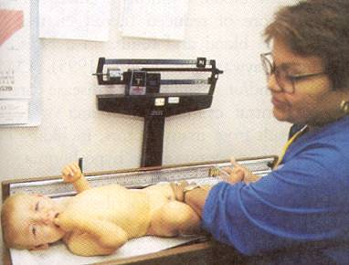
Height Measurement
Infants head is against end point and legs fully extended.

Slide 34
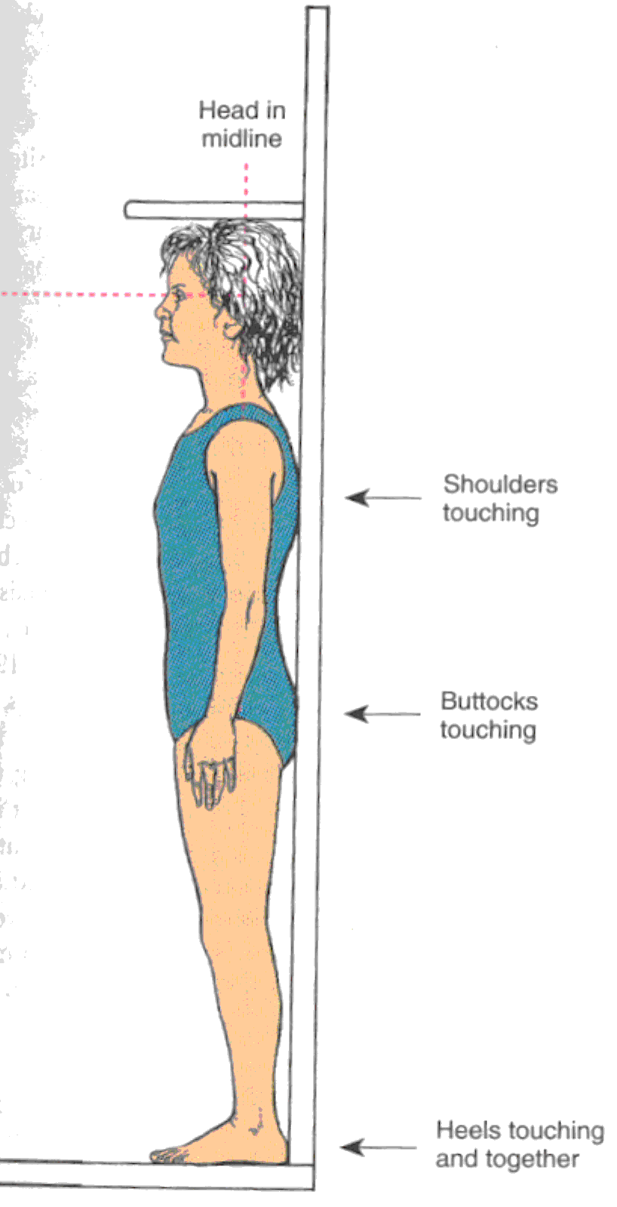
Height Measurement
Child is measured while
standing in stocking or
bare feet with the heels
back and shoulders touching
the wall.

Slide 35
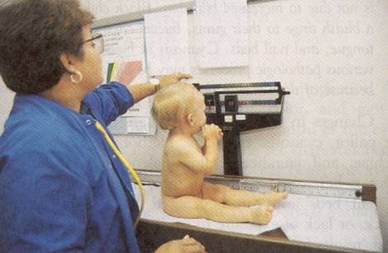
Weight
Note close proximity of nurses hands for safety

Slide 36
Weight
Needs to be recorded on a growth chart
Newborn may lose up to 10% of birth weight in 3-4 days.
Gains about ½ to1 oz per day after that
Too much or too little weight gain needs to be further investigated.
Nutritional counseling

Slide 37
Weight norms
Double birth weigh by 5-6 months
Triple birth weight by 1 year

Slide 38
Nutrition
How much formula?
How often being breast fed?
Solid foods: 4 to 6 months of age
What are they eating?
Over 1 year: How much milk vs solid foods

Slide 39
Nutrition
School age: typical diet
Favorite foods
I always child if I were to ask their mom what do they need to eat more of what would she say?

Slide 40
Nutrition
Most common nutritional problems:
  Iron deficiency anemia
  Obesity
  Anorexia

Slide 41
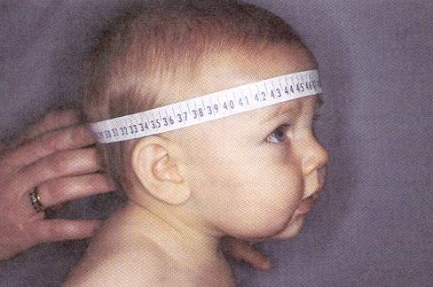
Head Circumference
Head circumference is measured by wrapping the paper
tape over the eyebrows and the around the occipital
prominence.

Slide 42
Head
Needs to be measured until age 2 years
Plot on growth curve
Check fontales:
  Anterior: 12 to 18 months
  Posterior: closes by 2-5 months
Shape: flat headed babies due to back-to-back sleep position

Slide 43
Mouth
Palate
Condition of teeth
Number of teeth
No teeth eruption by 12 months think endocrine disorder
Appliances
Brushing / visit to dentist

Slide 44
Eyes
Check for red-reflex
Can the infant see: by parent report
Strabismus:
  Alignment of eye important due to correlation with brain development
  May need to corrected surgically
5-year-old and up can have vision screening
  Refer to ophthalmologist if there are concerns

Slide 45
Common eye infections:
Conjunctivitis:
  A red-flag in the newborn may be STD from travel down the birth canal
  Pre-school: number one reason they are sent home: wash with warm water / topical eye gtts
  Inflammation of eye: history of juvenile arthritis

Slide 46
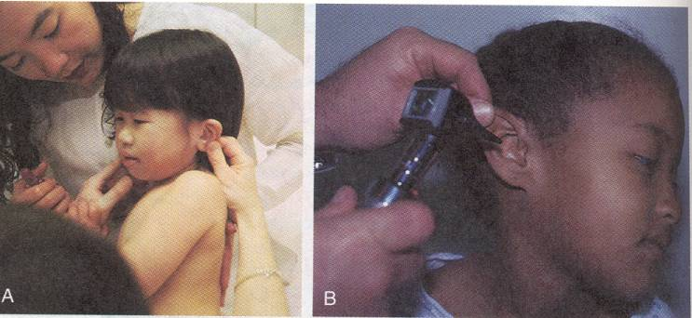
Ear Exam
Pinna is pulled down and back to straighten ear canal in
children under 3 years.

Slide 47
Otitis Media
Most common reason children come to the pediatrician or emergency room
Fever or tugging at ear
Often increases at night when they are sleeping
History of cold or congestion

Slide 48
Otitis
ROM: right otitis media
LOM: left otitis media
BOM: bilateral otitis media
OME: Otitis media with effusion
(effusion means fluid collection)
Pleural effusion, effusion of knee

Slide 49
Why a problem?
Infection can lead to rupture of ear drum
Chronic effusion can lead to hearing loss
OM is often a contributing factor in more serious infections: mastoiditis, cellulitis, meningitis, bacteremia
Chronic ear effusion in the early years may lead to decreased hearing and speech problems

Slide 50
Management
Oral antibiotics: re-check in 10 days
Tylenol for comfort
Persistent effusion:
  PET: pressure equalizing tubes
  Outpatient procedure
  Need to keep water out of ears
  Hearing evaluation
  Speech evaluation

Slide 51
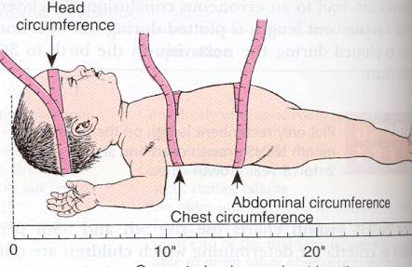
Head, chest, and abdominal circumference.
Whaley and Wong

Slide 52
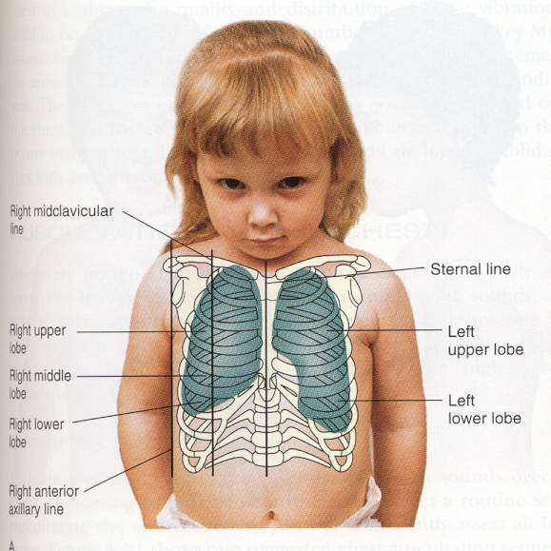
Child Chest
Ball and Bindler

Slide 53
Chest exam
A high percentage of admissions to hospital are respiratory: croup, bronchitis, pneumonia, and asthma
In the infant it is hard to separate upper air-way noises from lower air-way noises.
How does the child look? Color, effort used to breathe

Slide 54
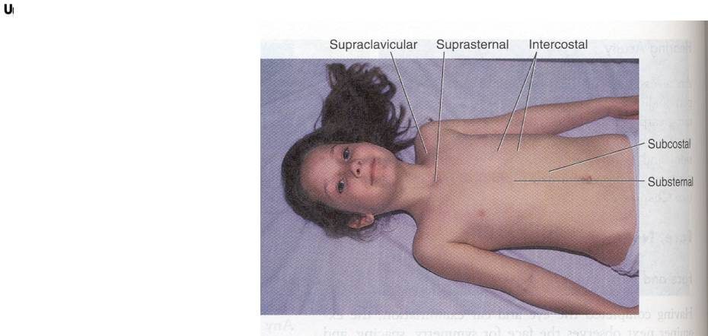
Possible Sites of Retractions
Observe while
infant or child
is quiet.
Bowden & Greenberg

Slide 55
Chest assessment
Retractions
  Subcostal
  Intercostal
  Sub-sternal
  Supra-clavicular
  Red flags: grunting / nasal flaring

Slide 56
Wheeze or Stridor
Wheezes occur when air flows rapidly through bronchi that are narrowed nearly to the point of closure.
Wheezes is lower airway
  Asthma = expiratory wheezes
A stridor is upper airway
  Inflammation of upper airway or FB

Slide 57
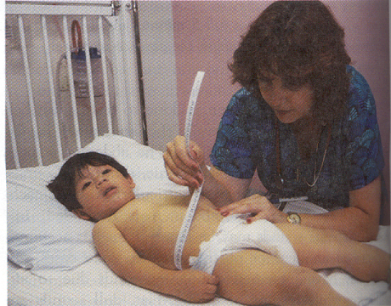
Abdominal Girth
Abdominal girth should be measured over the umbilicus
Whenever possible.

Slide 58
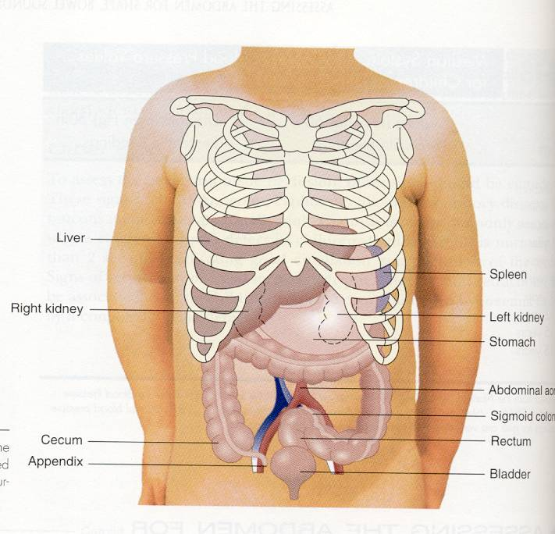
Abdomen
Ball & Bindler

Slide 59
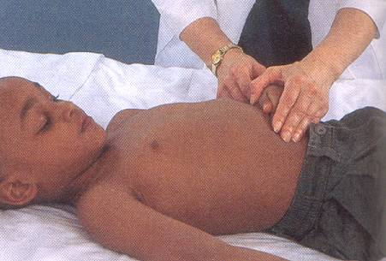
Abdominal Assessment
Pillitteri

Slide 60
Clinical Tip
Inspection and auscultation are performed before palpation and percussion because touching the abdomen may change the characteristics of the bowel sounds.

Slide 61
Bowel Sounds
Normally occur every 10 to 30 seconds.
Listen in each quadrant long enough to hear at least one bowel sound.
Absence of bowel sounds may indicate peritonitis or a paralytic ileus.
Hyperactive bowel sounds may indicate gastroenteritis or a bowel obstruction.

